Slide 1



Slide 2

Our Company
Our mission:
To make teachers’ lives easier!
Company Executives:
Jerry Yan
Chief Product Marketing Officer
David Ho pictures here ☺
Creative Director
Hamy Li
Chief Software Developer
Shuyu Zhang
Software Developer

Slide 3
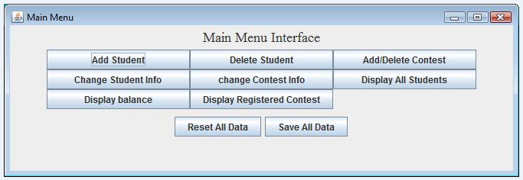

Slide 4
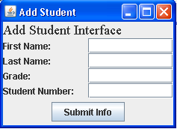
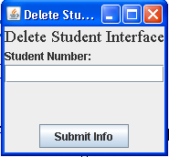
Interface
Clear Visual
Separated Panels for Different Functions

Slide 5
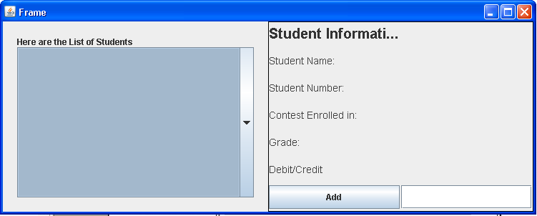
Operation
Interactive Buttons

Slide 6
Functionality
Organize Math Contest Information for each student
    Edit (Add/Delete)
    Search individual records of each student
    Update contest Information

Slide 7
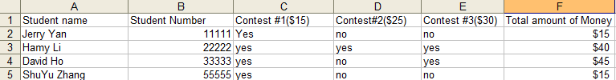

Comparisons With the Old Way
Old Way:
New Way:
Everything can be done with one click!

Slide 8

Our price is LOW LOW and LOW
Student package | Business package | Professional package
$20 | $25 | $30

Slide 9
Demo

Slide 10
Thank you!
Buy our product!

